Slide 1

CUSTOMER GRATIFICATION IN AIRLINE INDUSTRY Ms. Gavoury R¹, Sujitha D², Tharani R³
II M.sc. Information Techonology

Slide 2
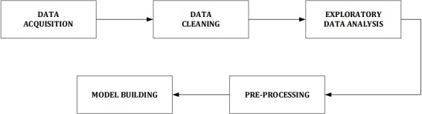
ABSTRACT
The airline industry is always focused on providing excellent customer service. It is crucial to determine the specific levels of satisfaction with which the airline passenger is satisfied or dissatisfied. The research is aimed at analysing the competition within the aviation industry and identifying the key factors contributing to its success. Through the implementation of machine learning classification algorithms, it is observed that the Random Forest Classifier achieves the highest accuracy rate of 96%. Hence, it will help airline companies to adjust their service value and demand to satisfy customers’ satisfaction.
METHODOLOGY

Slide 3
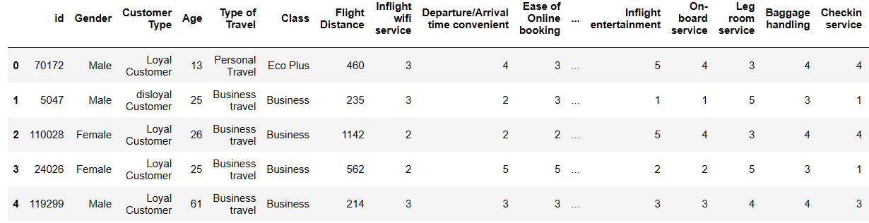
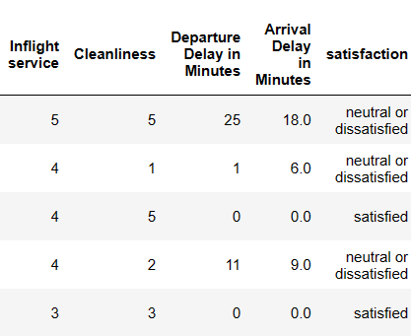
DATASET DETAIL
Source : Kaggle Attributes : 25 Total rows: 103904

Slide 4
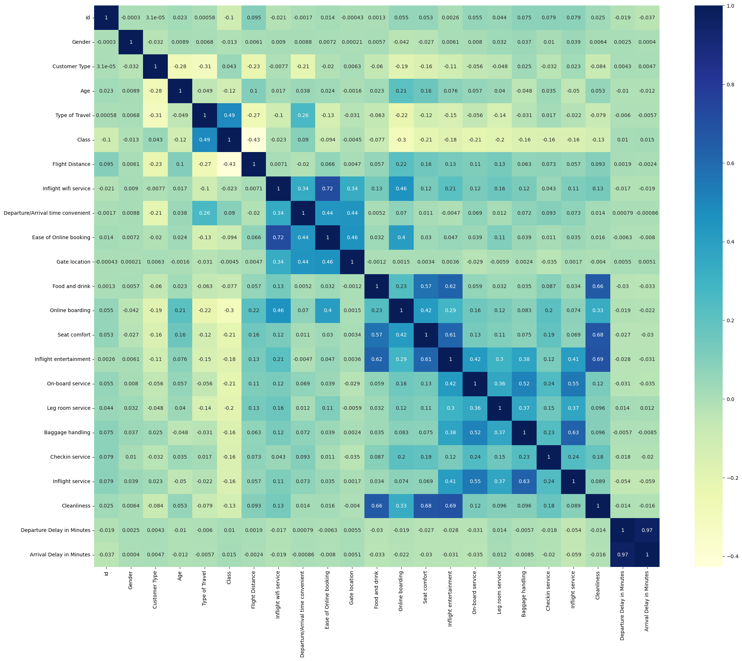
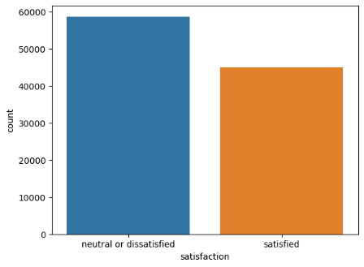
EXPLORATORY DATA ANALYSIS

Slide 5
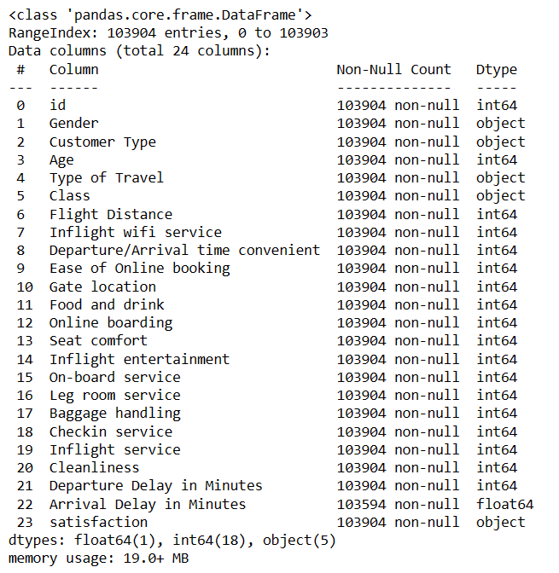
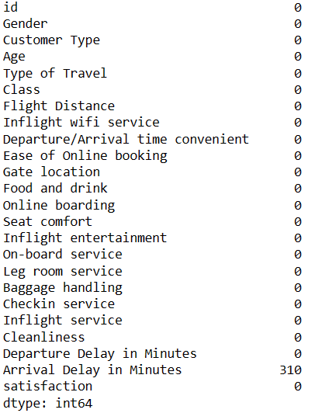
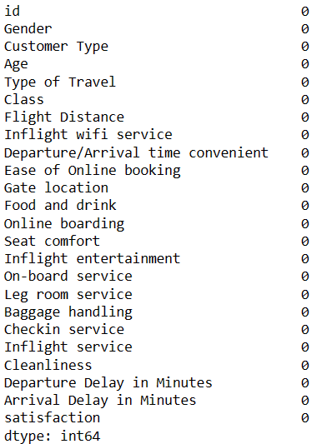
DATASET INFOMATION

Slide 6
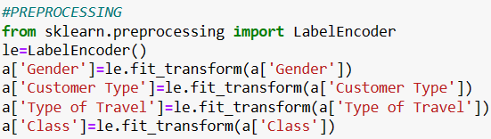
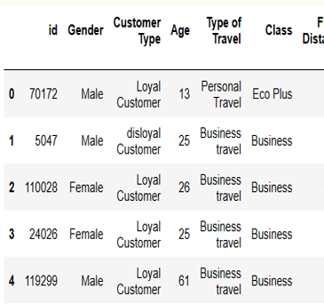
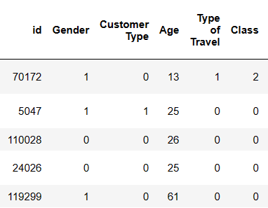
PREPROCESSING
BEFORE LABEL ENCODING
AFTER LABEL ENCODING

Slide 7
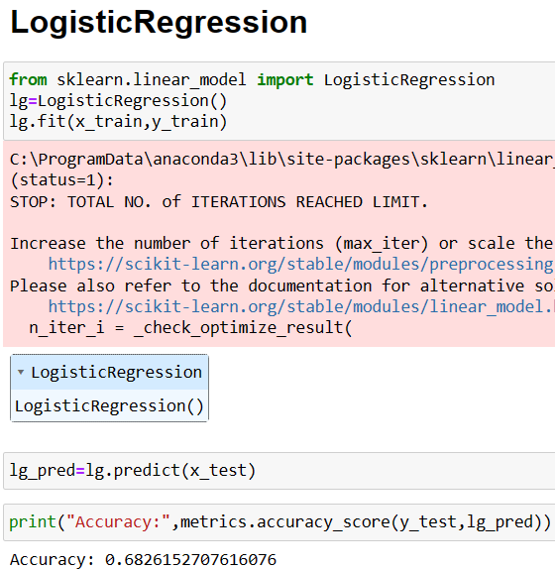
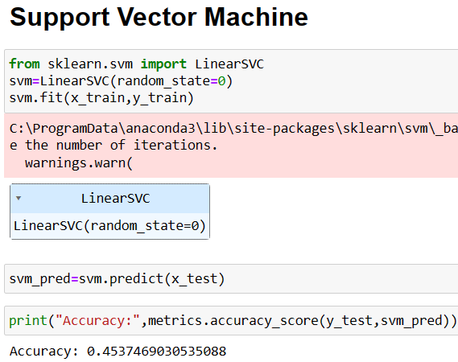
MACHINE LEARNING MODELS

Slide 8
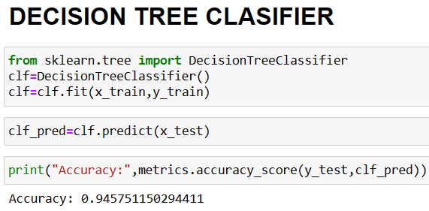
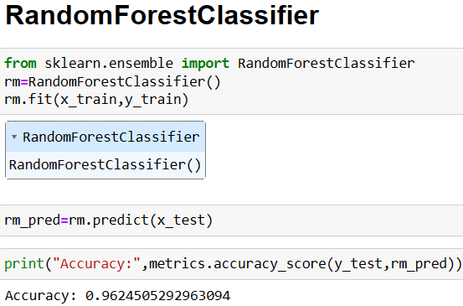
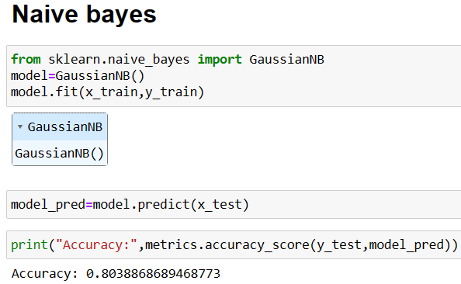

Slide 9
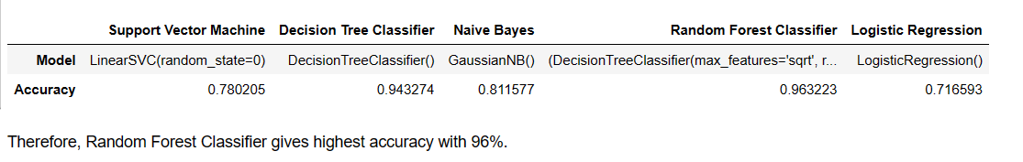
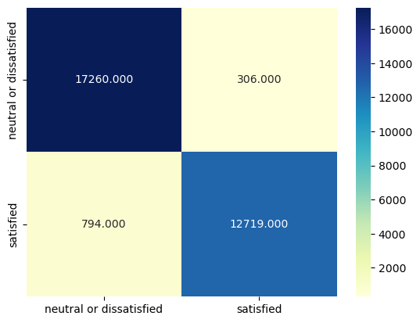
RANDOM FOREST CLASSIFIER

Slide 10
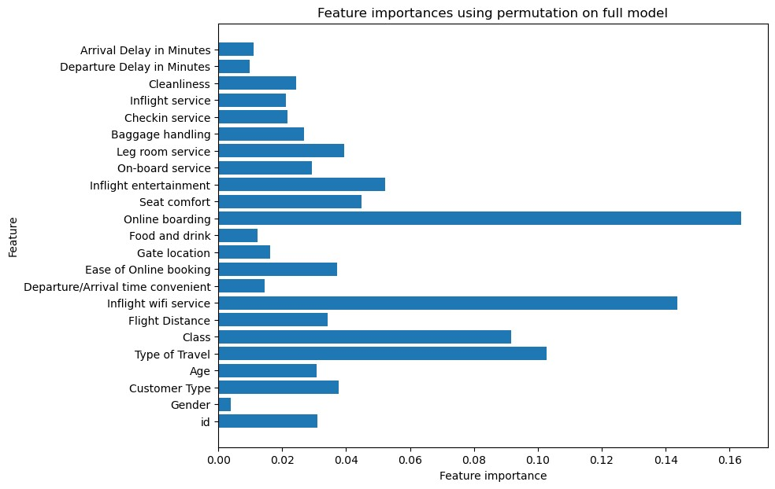
Feature importance

Slide 11
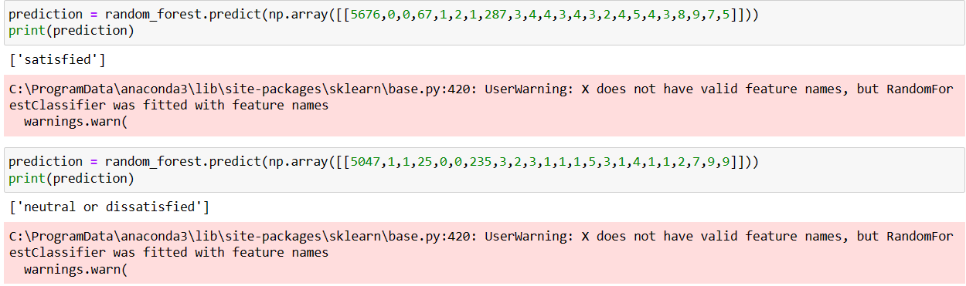
conclusion
With the influence of technology in all industrial fields, airlines can use Machine Learning to find the essential points that make passengers feel satisfied with airline services. The airline can also classify the rating given by the passenger to find out whether the passenger is satisfied or not with the service that has been provided. It can be concluded that the best model in this case study is Random Forest with a Accuracy value of 96% and the model generation time is the fastest compared to other algorithms that have been made in this study.

Slide 12
THANK YOU
gavouryr.csc@mopvaishnav.ac.in
sujithadmy@gmail.com
tharaniravi2702@gmail.com

